Slide 1
GROUP4
Shiny App Presentation
GUO TAO
LIU FANGBING
LIU MINGMING
YU LINNA

Slide 2
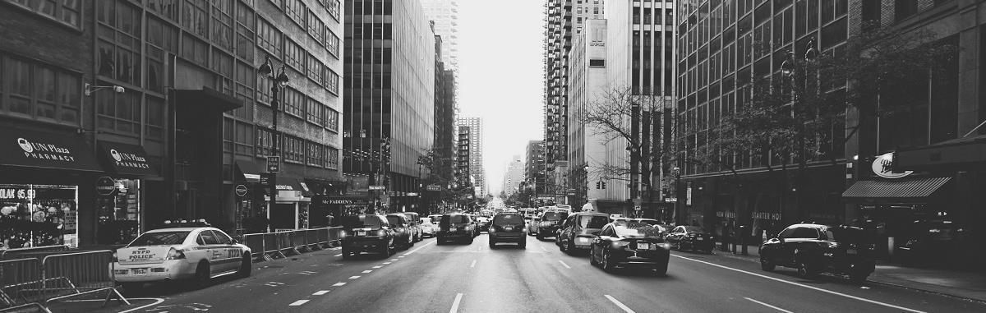
APP DESCRIPTION
WHAT IT IS?
WHAT MAKES IT DIFFERENT?
New York Trip Planner
Provide more than 10 recommendations in different categories.
Visualize the best route
WHO CAN USE IT?
Everyone !

Slide 3
NEW YORK TRIP PLANNER
MUSEUMS
RESTAURANTS
PARKS
THERTHERS
CHOOSE THE TAGS.
FOLLOW THE BEST ROUTE .
ENTER STARTING PIONT
.
CHICK THE PLACES YOU LIKE TO GO

Slide 4
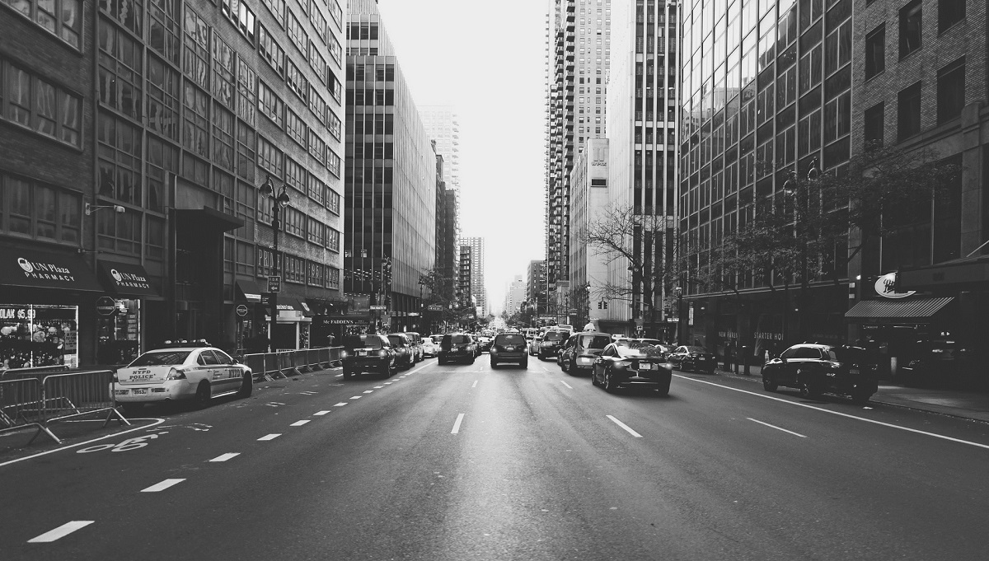
TSP PROBLEM
Travelling salesman problem
"Given a list of cities and the distances between each pair of cities, what is the shortest possible route that visits each city and returns to the origin city?"
NP-hard problem in combinatorial optimization

Slide 5


LETS EXPLORE THE APP！
Website
https://columbiaads-gourp4-project2.shinyapps.io/group4-explore_nyc/

Slide 6
THANKS FOR WATCHING

